Slide 1
Data and Algorithm 13
Chulalongkorn University
School of Integrated Innovation
Fall 2023
Marko Niinimaki Marko.N@chula.ac.th

Slide 2
Today’s main topics
“The data structures you will need for AI courses”: Queue, Stack, Priority Queue.
Last week: Text databases, Cloud applications.
https://markochula.pythonanywhere.com/dbnice [formatting]
https://markochula.pythonanywhere.com/search [actual search]

Slide 3
Where are we?
13 | 07 Nov | Stacks, Queues and Heaps
14 | 14 Nov | Working with Data
15 | 21 Nov | Summary (no class)
Please check the Exam Instructions in the Course Material

Slide 4
From last week
I explained this badly: Recall and precision.
Let's think we have 20 documents in our library. 10 of them are about cats. 10 are not.
The user wants cat documents. Maybe writes "cats"
Recall: "Let's just give everything. Then we'll automatically give correctly the cat documents too". So the recall is good, we did not miss anything.
But the precision is bad. Only 10/20 of the documents were relevant to the user's request.
A real library system example: https://inspirehep.net/
Our limited example with search: https://markochula.pythonanywhere.com/search

Slide 5
Lists
NB: The numbers inside the nodes do not mean anything. They are there just to illustrate that we can store data in the nodes.
L
5
8
6
3
4
How to add an "element" (but we call them nodes) in the beginning?
Let’s call the red arrow “List pointer”. Copy it.
Allocate a new node. Put the copy of the list pointer to the new node’s next pointer. Make the List pointer point to the new node.
O(1) operation.

Slide 6
Lists
head
4
5
8
6
L
3
tail
7
How about adding an element at the end of the list (like Python’s append operation)?

Slide 7
Lists
head
4
5
8
6
L
3
tail
7
Same idea as adding in the front. Copy the “tail” pointer. Make a new node. Turn the last node’s next pointer point to it. Point the tail pointer to the new node. O(1) again.

Slide 8
Lists
head
4
5
8
6
L
3
tail
7
How to remove from the front? If the head pointer is not null, jump over the first item (and return it).

Slide 9
Lists
head
L
5
8
6
3
tail
7
How to remove from the front? If the head pointer is not null, jump over the first item (and return it). O(1).

Slide 10

Lists
We can add at the back, remove from the front: A queue!
Technical names for the operations: enqueue, dequeue.
Technical name for the data structure:
FIFO (first in first out).

Slide 11
Lists
#FIFO - queue
from collections import deque
myds = deque()
myds.append(1) #enqueue to the right
myds.append(2)
x = myds.popleft() #dequeue from the left
print(x)
x = myds.popleft()
print(x)

Slide 12

Lists
But we know that we add and remove in the front of the queue, too. Both these operations are O(1).
Technical names for the operations: push, pop.
Technical name for the data structure:
LIFO (last in first out) or FILO.

Slide 13
Lists
#LIFO - stack: add and remove on the same side
#(right in this case)
from collections import deque
myds = deque()
myds.append(1)
myds.append(2)
x = myds.pop()
print(x)
x = myds.pop()
print(x)

Slide 14
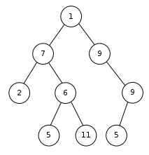
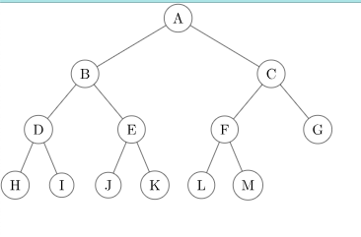
Trees .. and a heap
In computer science, a binary tree is a data structure in which each node has at most two children, referred to as the left child and the right child.
The topmost mode is called the root of the tree.
In a complete binary tree, all levels are filled except the lowest level nodes, which are filled from the left.
The number of nodes is about l² where l is the number of levels.

Slide 15
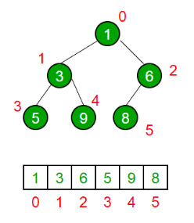
Trees .. and a heap
How to represent a complete binary tree in a list (array)? Start from the root node and fill the list by traversing the tree level by level.
How do the indexes (indices) of the list work?
L[(i-1)/2] is the position of the parent. In the example, node (3) has position 1 so its parent has position 0.
L[(2*i)+1] is the position of the left child.
L[(2*i)+2] is the position of the right child.

Slide 16
Trees .. and a heap
A complete binary tree is a minheap if for all of its nodes:
If it has children, they have bigger or equal values than the node.
The example below is a minheap.
Finding the minimal (smallest) element of a minheap is easy: it’s the root node so it has to be in L[0] in the list presentation. “Find smallest” is O(1). But how can we make sure the heap is still a heap if the remove the smallest element?

Slide 17
Trees .. and a heap
Delete the top element, then move the last element on top!
8
1
3
6
3
6
But it’s no longer a minheap.. So swap elements until it is.
5
9
8
5
9

Slide 18
Trees .. and a heap
Is the node bigger than either of its children? If it is, swap it with the/one of the smaller ones and continue.
3
3
8
6
5
6
5
9
8
9

Slide 19
Trees .. and a heap
But we are always going down/swapping elements by level..
Whereas the number of nodes is about levels * levels.
So making the heap to be a heap again after removing the root is O(log n)
3
5
6
8
9

Slide 20
Trees .. and a heap
Adding a new node. It can only go to “down and left” because this is a complete binary tree,
3
5
6
But now it is not a heap!
Swap the added element up until it is.
8
9
1

Slide 21
Trees .. and a heap
The add operation is, too, O(log n).
Swap the added element up. The parent is always in position L[(i-1)/2].
3
1
5
1
5
3
8
9
6
8
9
6

Slide 22
Trees .. and a heap
Swap the added element up. The parent is always in position L[(i-1)/2].
Let's start w an empty heap and just add some random elements. The number of elements is of course n.
3,1,5
Each add operation is O(log(n))
Adding all the elements is O(n * log(n))
We built a tree in O(n log(n)). Let's take the elements off. Taking the elements off O(n log(n))
3
1
3

Slide 23

Trees .. and a heap
A minheap is a data structure where we can get the smallest element with O(log n) and put in any element with O(log n).
It’s called a priority queue. “You are next because you have the smallest number” (like in a Thai Post Office).
[But maybe you rigged the machine to get a low number so it’s not necessarily first come/first serve].
A real world example: ambulances really do have a priority in congested traffic.

